Slide 1

EEL 4781 Computer Communication Networks Chapter 2-4: Application Layer
Xin Xin
Department of Electrical and Computer Engineering
University of Central Florida

Slide 2
Agenda
Video Streaming and CDN
DASH
CDN
Socket Programming
UDP
TCP
Chapter 2 Summary

Slide 3




Video Streaming and CDN
Killer-application
stream video traffic: major consumer of Internet bandwidth
Netflix, YouTube, Amazon Prime: 80% of residential ISP traffic (2020)
challenge: scale - how to reach ~1B users?
challenge: heterogeneity
different users have different capabilities (e.g., wired versus mobile; bandwidth rich versus bandwidth poor)
solution: distributed, application-level infrastructure

Slide 4

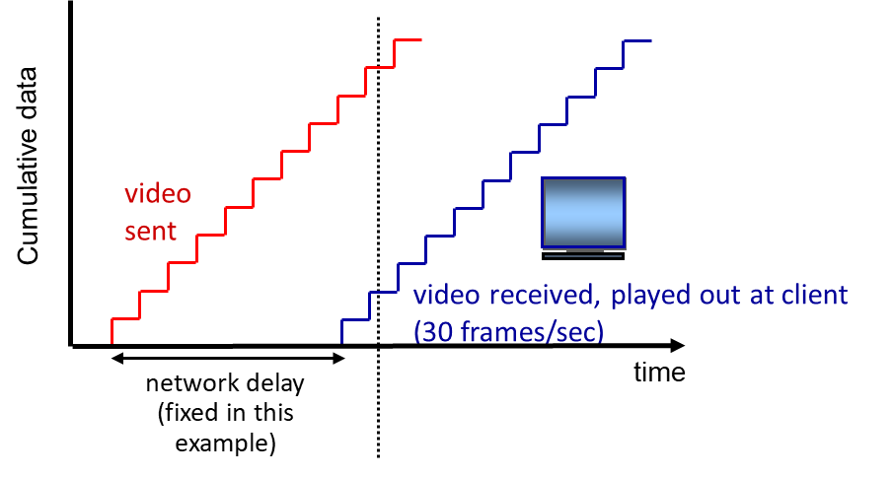
Video Streaming and CDN
spatial coding example: instead of sending N values of same color (all purple), send only two values: color value (purple) and number of repeated values (N)
Multimedia: video
coding: use redundancy within and between images to decrease # bits used to encode image
spatial (within image)
temporal (from one image to next)
streaming: consecutive and pipelined
at a specific time, client playing out early part of video, while server still sending later part of video
………………..
………………..
temporal coding example: instead of sending complete frame at i+1, send only differences from frame i
frame i
frame i+1

Slide 5
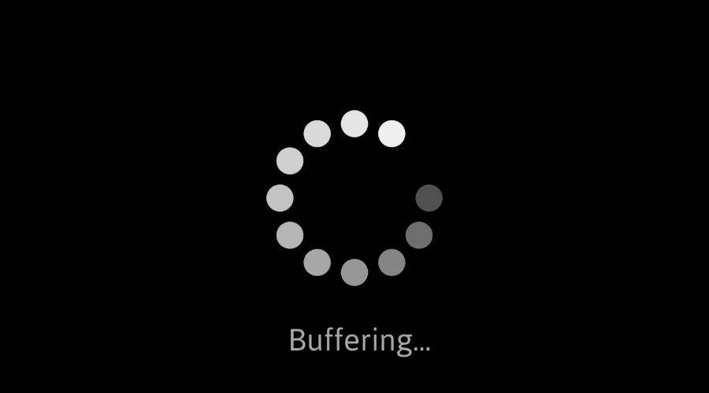
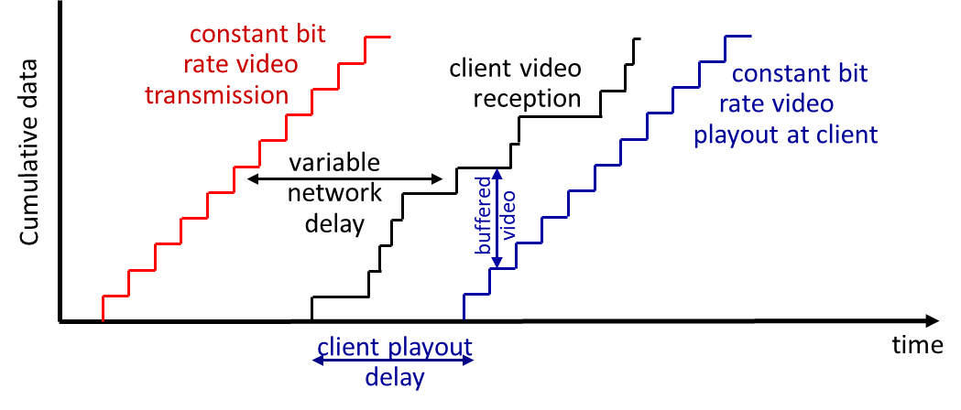
Video Streaming and CDN
Challenge1: Streaming vs Various Network Delay
continuous playout constraint: during client video playout, playout timing must match original timing
… but network delays are variable (jitter), so will need client-side buffer to match continuous playout constraint
client-side buffering and playout delay: compensate for network-added delay, delay jitter

Slide 6
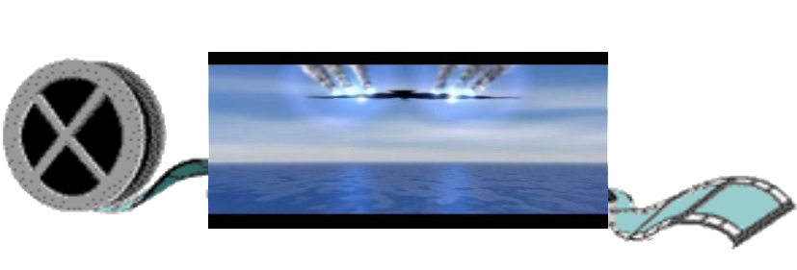
Video Streaming and CDN
Streaming multimedia: DASH
Dynamic, Adaptive Streaming over HTTP
server:
divides video file into multiple chunks
each chunk encoded at multiple different rates
different rate encodings stored in different files
files replicated in various CDN nodes
manifest file: provides URLs for different chunks
...
...
?
...
client
client:
periodically estimates server-to-client bandwidth
consulting manifest, requests one chunk at a time
chooses maximum coding rate sustainable given current bandwidth
can choose different coding rates at different points in time (depending on available bandwidth at time), and from different servers

Slide 7


Video Streaming and CDN
Challenge2: Stream to Numerous Simultaneous Users
how to stream content (selected from millions of videos) to hundreds of thousands of simultaneous users?
option 1: single, large “mega-server”
option 2: Content distribution networks(CDN)
….quite simply: this solution doesn’t scale
store/serve multiple copies of videos at multiple geographically distributed sites
enter deep: push CDN servers deep into many access networks
close to users
Akamai: 240,000 servers deployed in > 120 countries (2015)
bring home: smaller number (10’s) of larger clusters in POPs near access nets
used by Limelight

Slide 8
Agenda
Video Streaming and CDN
DASH
CDN
Socket Programming
UDP
TCP
Chapter 2 Summary
Notes:
Whatsapp instant message applications distributed hash table (DHT)

Slide 9
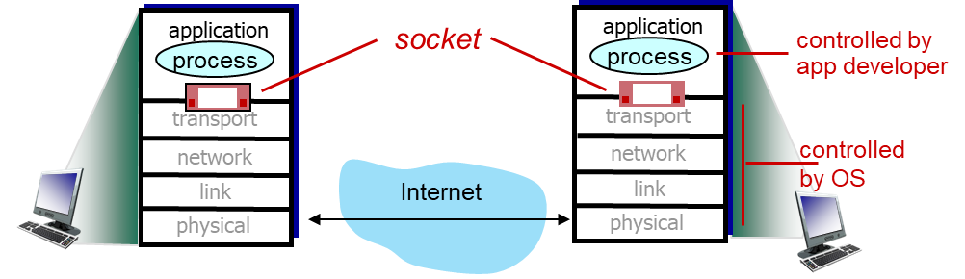
Socket programming
socket: door between application process and end-end-transport protocol
Application Example:
client reads a line of characters (data) from its keyboard and sends data to server
server receives the data and converts characters to uppercase
server sends modified data to client
client receives modified data and displays line on its screen
Two socket types for two transport services:
UDP: unreliable datagram
TCP: reliable, byte stream-oriented

Slide 10

UDP: no “connection” between client and server:
no handshaking before sending data
sender explicitly attaches IP destination address and port # to each packet
receiver extracts sender IP address and port# from received packet
server (running on serverIP)
client
create socket:
create socket, port= x:
clientSocket =
socket(AF_INET,SOCK_DGRAM)
serverSocket =
socket(AF_INET,SOCK_DGRAM)
Create datagram with serverIP address
And port=x; send datagram via clientSocket
read datagram from
serverSocket
write reply to
serverSocket
specifying client address,
port number
read datagram from
clientSocket
close
clientSocket
10

Slide 11
Example app: UDP client
Python UDPClient
include Python’s socket library
from socket import *
serverName = 'hostname'
serverPort = 12000
clientSocket = socket(AF_INET,
SOCK_DGRAM)
message = input('Input lowercase sentence:')
clientSocket.sendto(message.encode(),
(serverName, serverPort))
modifiedMessage, serverAddress =
clientSocket.recvfrom(2048)
print(modifiedMessage.decode())
clientSocket.close()
create UDP socket
get user keyboard input
attach server name, port to message; send into socket
read reply data (bytes) from socket
print out received string and close socket
11
Notes:
UDO and TCP code updates 3/23

Slide 12
Example app: UDP server
Python UDPServer
from socket import *
serverPort = 12000
serverSocket = socket(AF_INET, SOCK_DGRAM)
serverSocket.bind(('', serverPort))
print('The server is ready to receive')
while True:
message, clientAddress = serverSocket.recvfrom(2048)
modifiedMessage = message.decode().upper()
serverSocket.sendto(modifiedMessage.encode(),
clientAddress)
create UDP socket
bind socket to local port number 12000
loop forever
Read from UDP socket into message, getting client’s address (client IP and port)
send upper case string back to this client
12

Slide 13
TCP: “connection” between client and server:
handshaking before sending data
when client creates socket: client TCP establishes connection to server TCP
when contacted by client, server TCP creates new socket for server process to communicate with that particular client
server (running on hostid)
client
create socket,
port=x, for incoming request:
serverSocket = socket()
wait for incoming
connection request
TCP
connection setup
create socket,
connect to hostid, port=x
connectionSocket =
serverSocket.accept()
clientSocket = socket()
read request from
connectionSocket
send request using
clientSocket
write reply to
connectionSocket
read reply from
clientSocket
close
connectionSocket
close
clientSocket
13

Slide 14
Example app: TCP client
Python TCPClient
from socket import *
serverName = 'servername'
serverPort = 12000
clientSocket = socket(AF_INET, SOCK_STREAM)
clientSocket.connect((serverName,serverPort))
sentence = input('Input lowercase sentence:')
clientSocket.send(sentence.encode())
modifiedSentence = clientSocket.recv(1024)
print ('From Server:', modifiedSentence.decode())
clientSocket.close()
create TCP socket for server, remote port 12000
No need to attach server name, port
14

Slide 15
Example app: TCP server
Python TCPServer
from socket import *
serverPort = 12000
serverSocket = socket(AF_INET,SOCK_STREAM)
serverSocket.bind(('',serverPort))
serverSocket.listen(1)
print('The server is ready to receive')
while True:
connectionSocket, addr = serverSocket.accept()
sentence = connectionSocket.recv(1024).decode()
capitalizedSentence = sentence.upper()
connectionSocket.send(capitalizedSentence.
encode())
connectionSocket.close()
create TCP welcoming socket
server begins listening for incoming TCP requests
loop forever
server waits on accept() for incoming requests, new socket created on return
read bytes from socket (but not address as in UDP)
close connection to this client (but not welcoming socket)
15

Slide 16
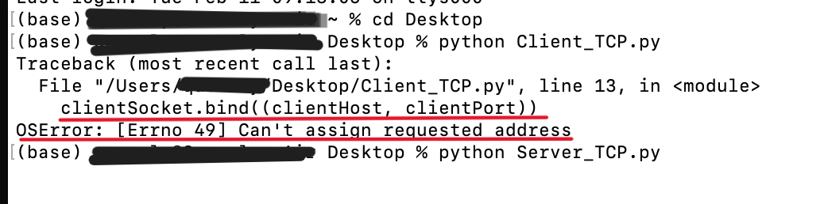
Hw2
16

Slide 17
Chapter 2: Summary
our study of network application layer is now complete!
application architectures
client-server
P2P
application service requirements:
reliability, bandwidth, delay
Internet transport service model
connection-oriented, reliable: TCP
unreliable, datagrams: UDP
specific protocols:
HTTP
SMTP
DNS
BitTorrent (P2P)
video streaming, CDNs
socket programming:
TCP, UDP sockets
important themes:
centralized vs. decentralized
stateless vs. stateful
Scalability
caching
reliable vs. unreliable message transfer
“complexity at network edge”
……
17

Slide 18
Thanks
Acknowledgment
The materials for this course are in part based upon the materials from a number of people/sources, including:
Official website of the Kurose and Ross text: Computer Networking: A Top-Down Approach
Official website of the Tanenbaum & Wetherall text: Computer Networks
Dr. Murat Yuksel: https://www.ece.ucf.edu/~yuksem/teaching/EEL-4781-Fall-2020.html
Dr. Raj Jain: https://www.cse.wustl.edu/~jain/

Slide 19
Recap
HTTP (HyperText Transfer Protocol)
Application:
Paradigm:
Service:
Format
Request: GET, HEAD, POST, PUT (pull or push?)
Response
Features:
Non-persistent vs Persistent: how many RTTs
Stateless vs Stateful: cookies
Web Cache: a case study
SMTP (Simple Mail Transfer Protocol)
Application:
Paradigm:
Service:
Format
Extra handshake
Features:
pull or push?
To pull a message: IMAP, POP3, HTTP
DNS (Domain Name System Protocol)
Application: DNS
Why DNS?
Translate what?
Hierarchical Structure
Paradigm:
Service:
Format
(optional)
Features:
Local DNS: challenge
Recursive vs Iterative
BitTorrent (BitTorrent Protocol)
Application: BitTorrent (file distribution)
Tracker vs Peers
Paradigm:
Service:
Format
(optional)
Features:
Reciprocate: higher upload rate, better trading partners, get file faster
Transport Layer: 3-19

Slide 20
Recap
HTTP (HyperText Transfer Protocol)
Application: Web
Paradigm: S-C
Service: TCP
Format
Request: GET, HEAD, POST, PUT (pull or push?)
Response
Features:
Non-persistent vs Persistent: how many RTTs
Stateless vs Stateful: cookies
Web Cache: a case study
SMTP (Simple Mail Transfer Protocol)
Application: Email
Paradigm: S-C
Service: TCP
Format
Extra handshake
Features:
push
To pull a message: IMAP, POP3, HTTP
DNS (Domain Name System Protocol)
Application: DNS
Why DNS? url -> ip translation
Translate what? hostname
Hierarchical Structure
Paradigm: S-C
Service: UDP
Format
(optional)
Features:
Local DNS: challenge
Recursive vs Iterative
BitTorrent (BitTorrent Protocol)
Application: BitTorrent (file distribution)
Tracker vs Peers
Paradigm: P2P. In fact, hybrid!
Service: TCP
Format
(optional)
Features:
Reciprocate: higher upload rate, better trading partners, get file faster
Transport Layer: 3-20

Slide 21
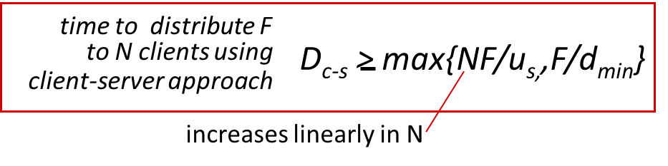
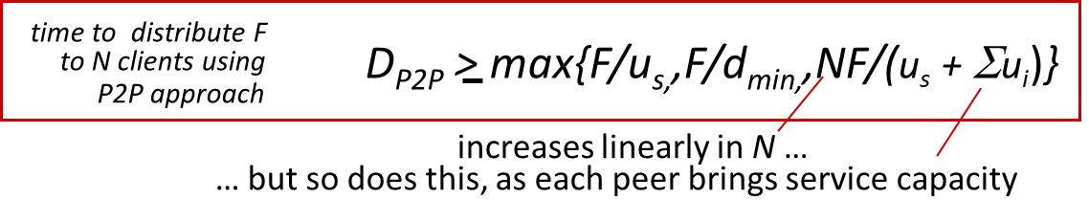
Recap
F
u_{s}
P2P features
Not always-on
Directly communicate
Self scalability
Intermittent behavior
Client-server vs P2P
Case studies
d_{i}
network
u_{i}
Transport Layer: 3-21

